Slide 1
Asset Pipeline
of Fools Engine
Work in progress

Slide 2
Asset Types
Texture
Texture2D
Shader
ShadingModel
Material
Mesh
RenderMesh
Model
Skeleton
SkinnedModel
Animation
Scene
Prefab
Audio

Slide 3
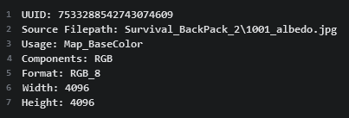

Import Model and On-Disk Structure
Asset’s data is not saved to disk after importing. Loading and importing processes are unified in the editor. Import settings for a given asset are saved in an Asset file with metadata (eg. Texture resolution). Some assets have only Asset files and no Asset Source files (e.g. Materials).
Setting import options is necessary only once (unless a change in the Asset Source File creates a need for adjustment).
Assets can be hot-reloaded at the editor’s runtime or the runtime of a non-distribution game build without manual reimporting.
Asset data is stored on disk in one form without duplication.
Asset’s metadata are always loaded and available.
Disk
Asset Source
Asset
Examples
Asset
Texture
Mesh
Asset Source
Asset
Asset
Asset

Slide 4
Runtime structure
Editor and Game
Assets are broken down into components and stored in ECS.
Components use AC prefix (from Asset Component).
Common Components:
ACAssetType
ACUUID
ACFilepath
ACSourceFilepath
ACRefsCounters
Asset does not have to have all of those components (more on that later).
Every asset has a CoreComponent, that is different for every Asset type.
It contains metadata about the asset and a pointer to the data in CPU memory.
CPU side representation of GPU stored copy of the asset is also a component.
AssetsManager
ECS

Slide 5
Asset Archetypes
Project Asset
Assets that the game developer operates on.
Unit Asset
Unit Assets are only ever referenced by other assets. They are conceptually parts of Project Assets and they get imported and loaded together. They are fully hidden from the user.
Editor Asset
Assets used by only by editor (e.g. icons).
Base Asset
Assets build-in to the engine used by default.
Components:
ACAssetType
ACUUID
ACFilepath
ACSourceFilepath (if needed)
ACRefsCounters
CoreComponent (asset’s meta data and ptrs to data)
other, asset type specific components
Components:
ACAssetType
ACUUID
ACProjectAsset
other, asset type specific, components
ACAssetType
CoreComponent
other, asset type specific components
Components
Components
ACAssetType
CoreComponent
other, asset type specific components
ACUUID
ACFilepath
CoreComponent

Slide 6
Asset
AssetID
Data
Composition structure of Rendering Assets
SkinnedModel
Model
RenderMesh
Mesh
Skeleton
Material
Texture2D
ShadingModel
Shader
Texture
Shader
ShadingModel
Shader
Shader parameters (samplers, uniforms)
Material
ShadingModel
N × Texture2D
Uniform Values
Mesh
Vertices and Indices
RenderMesh
Mesh
Material
Model
N × RenderMesh
Skeleton
Hierarchy of transforms with default values (base pose)
SkinnedModel
Skeleton
Model
Skinning

Slide 7
Scene Components for Geometry Assets
Geometry assets (sufficient for rendering on their own) have dedicated scene components.
CRenderMesh
AssetHandle<RenderMesh>
CModel
AssetHandle<Model>
CSkinnedModel
AssetHandle<SkinnedModel>
They also have scene components “simulating” them – asset views. This allows for runtime dynamic composition.
CRenderMeshView
AssetHandle<Mesh>
CModelView
Vector<AssetHandle<RenderMesh>>
CSkinnedModel
AssetHandle<Skeleton>
AssetHandle<Material>
Skinning
Vector<AssetHandle<RenderMesh>>

Slide 8
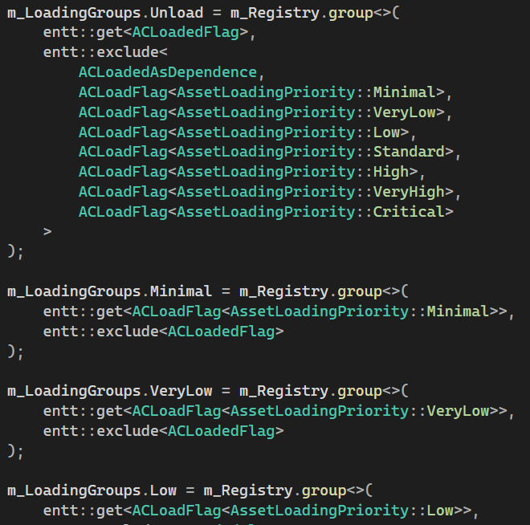
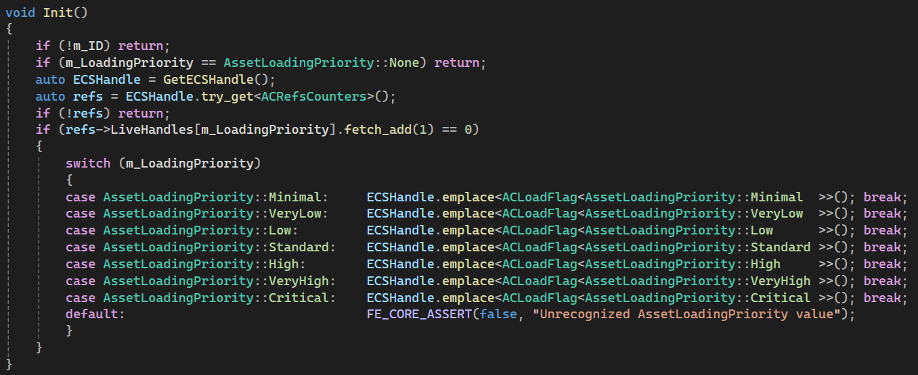
Runtime Management
Editor and Game
Load / unload lists
You can never assume an asset is loaded and there is no explicit asset loading request possibility. Instead, a handle to the asset has a loading priority value - enum.
Asset handles of each loading priority are atomically counted in a component of that asset (ACRefsCounters).
List of assets to load for given loading priority is maintained continuously by adding/removing empty component corresponding to given loading priority when reference count changes from/to 0.
Asset loading/unloading runs in an asynchronous loop, but in a foreground (structured concurrency).
This makes dynamic adaptive asset loading management much easier and safer (e.g. preloading assets for next level simply by setting their handles from None to Low). There is no need for the user to write asynchronous multithreaded code and still get it’s benefits.
AssetHandle

Slide 9
Access
AssetInterface
Generic interface to ECS
Observer
TextureObserver
TextureUser
User
Interface to a concrete Asset
Public only methods specific to its asset type
Can be conceptualized as an asset itself, but actually is just an ECS handle (Asset ID + Registry ptr)
Treats Asset as const
Extends Observer adding methods modifying an Asset
ShaderObserver
ShaderUser
MaterialObserver
MaterialUser
AudioObserver
AudioUser
AssetHandle< tnAsset >
AssetID + AssetLoadingPriority
.Observe()
.Use()
AssetObserver< tnAsset >
AssetUser< tnAsset >
Common (templated) derivation of all observers
Acting like a shared lock
Common (templated) derivation of all users
Acting like a unique lock

Slide 10
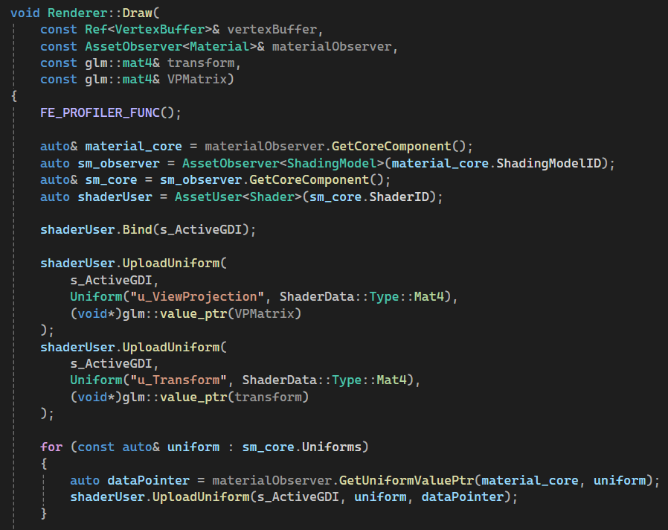
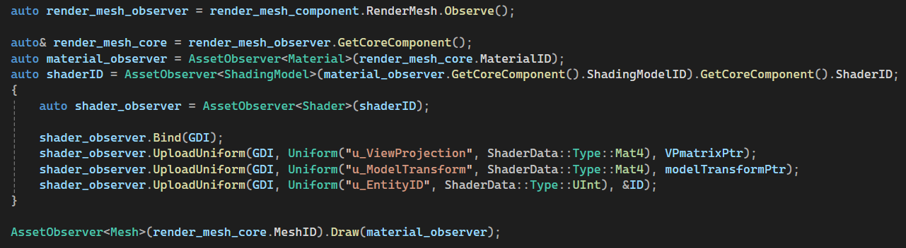
Synchronized Runtime Access
Examples

